Slide 1
OTITiS
Management of common ear infections
Dr Ben Vermaak
MB. Ch.B/LMCC/MMed

Slide 2
EAR ANATOMY
External or outer ear
Pinna or auricle.
External auditory canal or tube.

Slide 3
EAR ANATOMY
Tympanic membrane - tympanic membrane divides the external ear from the middle ear.
Middle ear
Ossicles transmit the sound waves to the inner ear.
Malleus
Incus
Stapes

Slide 4
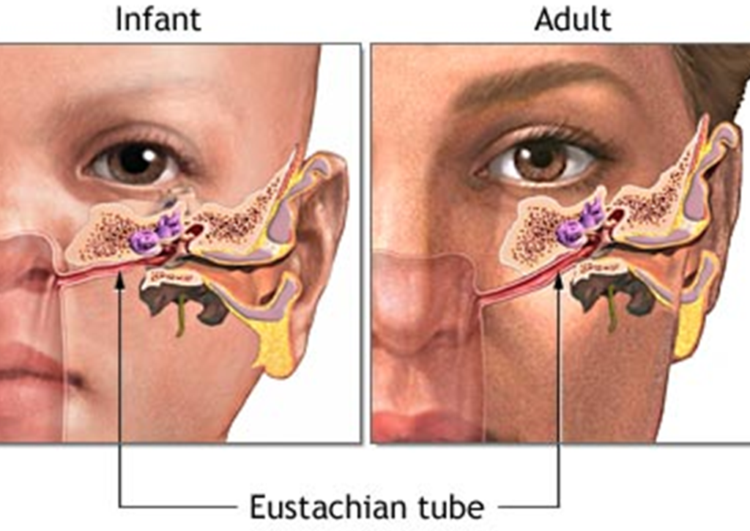
EAR ANATOMY
Eustachian tube.
helps to equalize the pressure in the middle ear.
tube is lined with mucous.

Slide 5
MIDDLE EAR

Slide 6
EUSTACHIAN TUBE

Slide 7
GLUE EAR

Slide 8
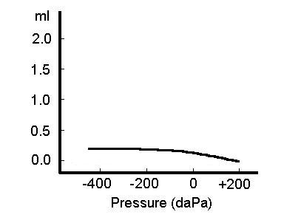
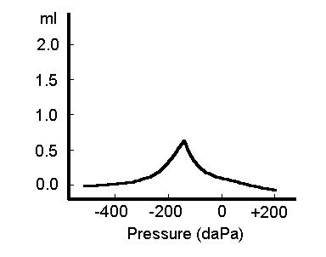
TYMPANOGRAM

Slide 9
RISK FACTORS
Crèche / Daycare
Parents smoking
Family history of Atopy
Lack of breastfeeding
Drinking bottle in prone position

Slide 10
GLUE EAR

Slide 11
MEDICAL MANAGEMENT
Systemic cortisone
Nasal cortisone
Nasal decongestion
Systemic antihistamine
What role does Antibiotic play?

Slide 12
GROMMET

Slide 13
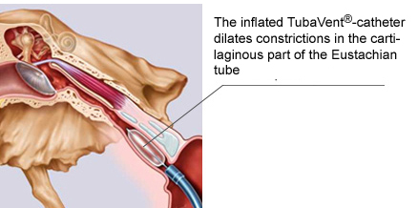
Eustachiantube Balloonplasty

