Slide 1
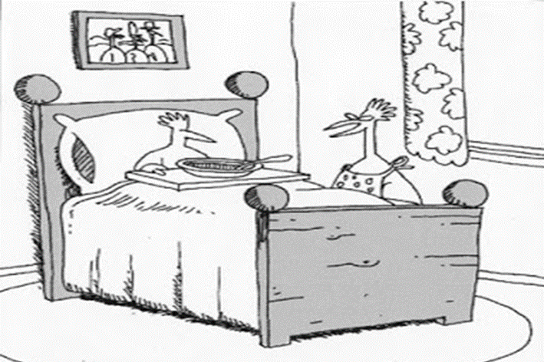
Mucociliary transport in chronic rhinosinusitis
“Quit complaining. For one thing, chicken soup is good for a cold.
For another, it’s nobody we know”
ENT private Practice
Durbanville

Slide 2
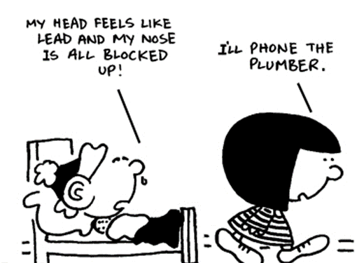
RHINOSINUSITIS
definition
“Sinusitis is not an entity in itself, but must be considered as an inflammatory disease involving the ostiomeatal complex, the nasal cavity, the nasopharynx and the upper and lower respiratory tracts”.
Josephson, 1994

Slide 3
Inflammation
All bacterial sinusitis will cause sinus inflammation but not all sinus inflammation is bacterial
Cause of nasal inflammation becomes more important in the understanding of the management of sinusitis
Bacterial
Viral
Allergy
Chemical (smoking)
Anatamical
stagnation occurs when two ciliated surfaces come into contact
this disrupts mucociliary mucus clearance

Slide 4
Inflammation is the main component of Acute Rhinosinusitis
virus
bacteria
TH₁
TH2
allergy
Inflammatory cells
and Mediators
Nasal congestion
Hiposmia
rhinorrhea
Facial pain
Sino-nasal
mucosa

Slide 5
Sinusitis Diagnosis
Comparison of Symptoms of Sinusitis, Allergies and Colds
Symptom | Sinusitis (Bacterial) | Allergies | Colds (Viral)
Facial pain or pressure | Yes | Sometimes | Sometimes
Duration of illness | More than 10-14 days | Varies | Fewer than 10 days
Nasal discharge | Thick, Yellow-green | Clear, thin, watery | Thick, whitish or thin
Fever | Sometimes | No | Sometimes
Headache | Sometimes | Sometimes | Sometimes
Pain in Upper Teeth | Sometimes | No | No
Bad breath | Sometimes | No | No
Coughing | Sometimes | Sometimes | Yes
Nasal congestion | Yes | Sometimes | Yes
Sneezing | No | Sometimes | Yes

Slide 6
Acute Rhinosinusitis: Definition
Increased symptoms after 5 days
Symptoms
persistent symptoms after 10 days
Colds
0
5
10
15
12
Days
Weeks
Adapted from Fokkens et al. EP³OS Guidelines. Rhinol Suppl. 2005;18:1.
Notes:
Fokkens et al. EP³OS Guidelines. Rhinol Suppl. 2005;18:1.

Slide 7
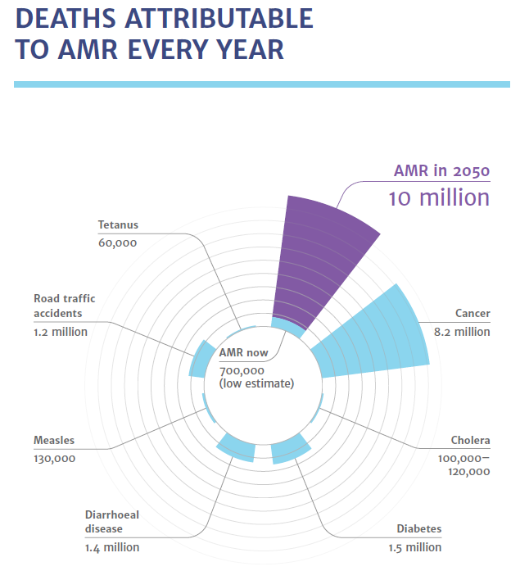
Antimicrobial Resistance: A crisis
Antibiotic resistance is a health threat globally²
Antimicrobial-resistant infections currently claim 700,000 lives a year globally¹
By 2050, antimicrobial resistance
could result in a loss of 10 million lives a year¹
More than people dying from cancer¹
Reference: 1. The Review on Antimicrobial Resistance: Tracking Drug-resistant infections globally: Final report and recommendations O’Neill J. May 2016. 2. Antimicrobial stewardship across 47 South African hospitals: an implementation study. Brink AJ. et al. Lancet Infect Dis 2016; 16: 1017–25

Slide 8
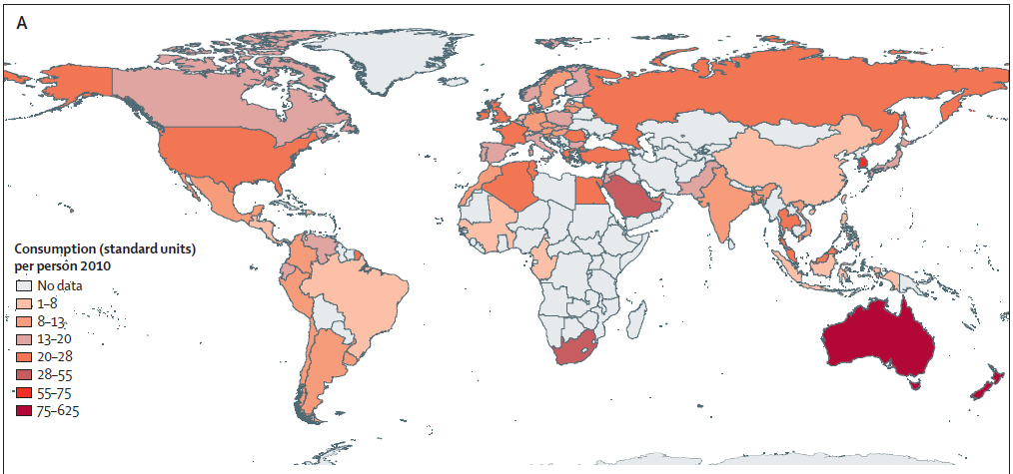
Antibiotic consumption 2000 to 2010 in SA
*
Antibiotic consumption increased substantially in developing countries, with the highest rates shown in countries like South Africa
* Expressed in standard units (ie, pill, capsule, or ampoule) per person
Reference: 1. Global antibiotic consumption 2000 to 2010: an analysis of national pharmaceutical sales data. Van Boeckel TP et al. Lancet Infect Dis 2014; 14: 742–50

Slide 9
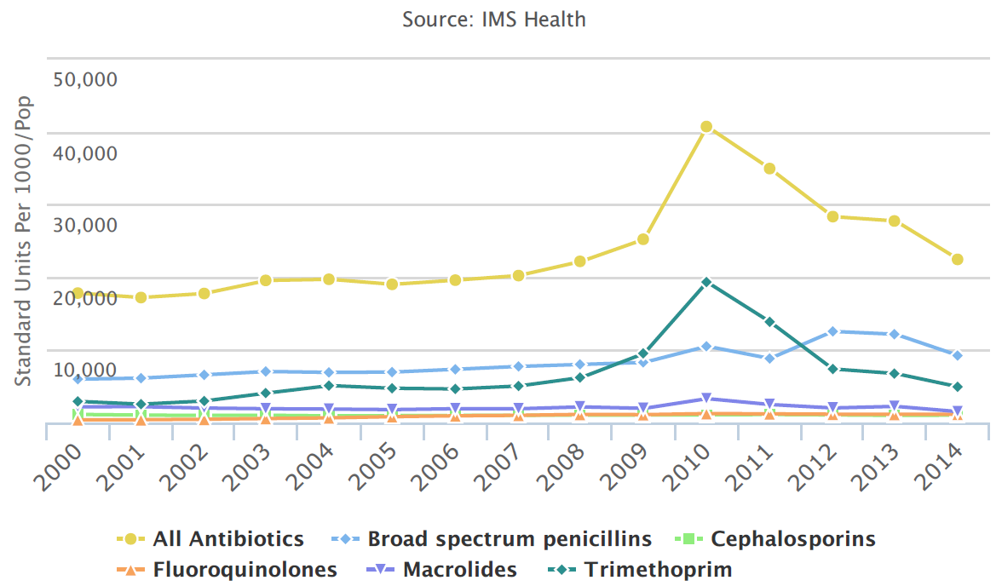
SA’s consumption alone increased by 175%²
Trend of Antibiotic Use in South Africa^{1,2}
Reference: 1. Antibiotic Use in South Africa, Center for Disease Dynamics, Economics & Policy. https://resistancemap.cddep.org/AntibioticUse.php 2. Antimicrobial Stewardship: The South African Perspective. Precious Matsoso Director General; National Department of Health; South Africa 13th November 2015. http://www.who.int/phi/implementation/Precious_Matsoso_MoH_South_Africa.pdf?ua=1

Slide 10
The Evolution of Bacteria on a “Mega-Plate” Petri Dish (Kishony Lab)

Slide 11
The problem
The rise of resistant microorganisms
there is a critical need to better understand how to stimulate and/or enhance innate immune responses as a therapeutic modality to treat respiratory infections.
Mucociliary clearance (MCC) is the primary physical defence of the respiratory tract against inhaled pathogens.
When MCC fails, respiratory infections becomes frequent

Slide 12
Introduction
Understanding the physiology and anatomy should guide our management.
helps in our conservative management
post surgical management.
Restoration of the respiratory function is the aim of both conservative and surgical therapies

Slide 13
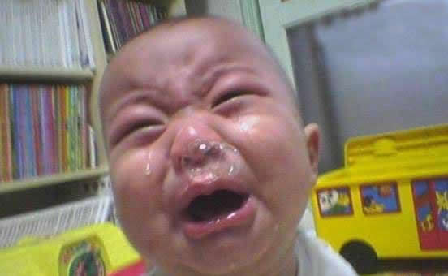
Why sinuses
Humidifying and warming inspired air
Increasing surface area for olfaction
Lightening the skull
Resonance
Absorbing shock
Any cavity, needs to
ventilate
drain
Cilia motility very important

Slide 14
Function of MCC
biphasic layer composed
an aqueous 'sol' layer
a superficial 'gel' layer. In the sol layer
lubricant sol layer enables the gel mucus present at the tips of the cilia to be transported by the ciliary beating of the ciliated cells
difficulties with sampling, little is known about the physical and biochemical properties of the sol layer.

Slide 15
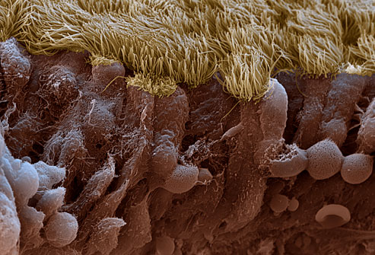
Introduction
Pseudo stratified columnar epithelium
ciliated cells (75%)
Containes microtubules and dynein arms
Provides ATPdriven motility
goblet cells (20%),
basal cells (5%)
Combination of mobile cilia and mucus make up MCC
Clears away inhaled particles and pathogens

Slide 16
Physiology
Columnar cells
up to 70% of the epithelium
300–400 microvilli on their surface
increases surface area to retain moisture and to prevent drying
Ciliated cell
20-50%
200–300 cilia on their surface
substrate of the mucociliary clearance
5 to 10 µm long and 250 nm thick
Goblet cells
represent 5–15% of cells
20-50%
200–300 cilia on their surface
substrate of the mucociliary clearance
5 to 10 µm long and 250 nm thick

Slide 17
Factors compromising mucociliary functions
Nasal irritants Infections
Excessive summer and excessive cold
Hypoxia Drugs (anaesthetics, sedatives, topical nasal decongestants, beta blockers)
Dry atmosphere
Smoking
Air pollutants

Slide 18
Effect of disease on mucous transport
Inflammatory mediators paralyze cilia
Dr James Palmer Rhinology Research Center at the University of Pennsylvania
The amount and nature altered
Becomes more viscous
Gel layer becomes thicker
Sol phase becomes extremely thin
Cilia immobilized by encroaching gel layer

Slide 19
Enzymes and immunoglobulins
Nasal secretions also contain an enzyme lysozyme which kills bacteria and viruses.
ImmunoglobulIns IgA and IgE, and interferon
present in nasal secretions
provide immunity against upper respiratory tract infections

Slide 20
Mucociliary clearance
It creates and moves a mucus blanket is cleared toward the nasopharynx every 10-15 minutes.
We clear 20-40cc of mucus daily.
MCC in the paranasal sinuses has an ORGANIZED, directed, NON-gravity dependent direction of flow.

Slide 21
Gel layer
Outer gel layer produces 1-2 L/day.
It contains
goblet cells
submucosal glands
mucin (glycoprotein)
IgA
albumin
Lactoferrin
lysozyme

Slide 22
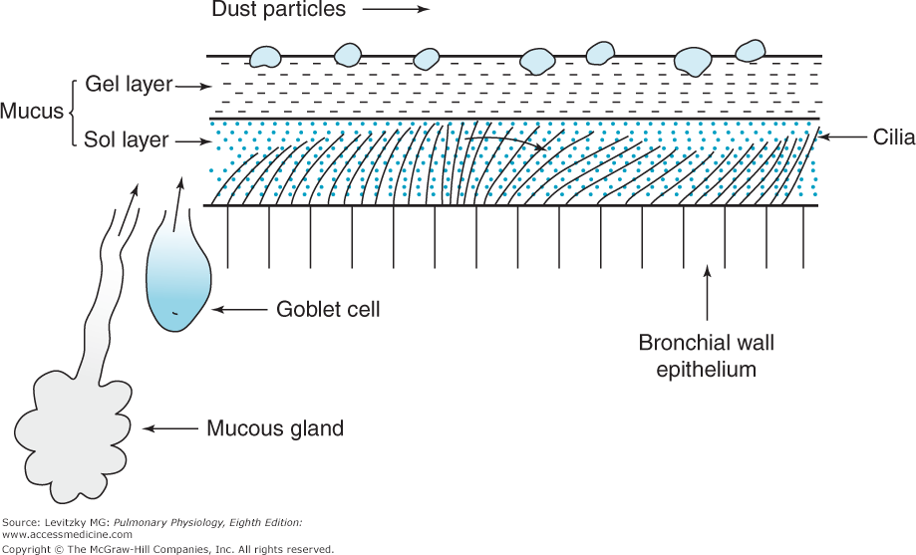
Gel – Sol Layer

Slide 23
Sol and gel layer: Viscosity of this layer is partly determined by ion channels. Ensure ion and water transport is balanced
Airway Surface Liquid (Gel)
Sol cilia: low-viscosity
Langerhans cells
Mucinous cell produce viscous secretion
Serous cell produce low-viscosity secretion

Slide 24
Mucociliary clearance (MCC)
MCC is one of the most important nonspecific defence mechanisms of the respiratory tract
Its impairment is a well-documented feature of chronic respiratory diseases
several inflammatory mediators influence the mucociliary apparatus
mucociliary apparatus consists of three functional compartments
the cilia
a protective mucus layer
an airway surface liquid (ASL) layer
All work in concert

Slide 25
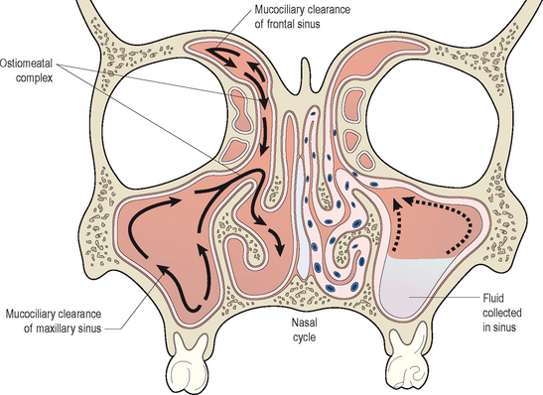
Function of MCC
Primary defence mechanism
To remove bacteria out of respiratory tracts before they have a chance to multiply.
MCC is slowed, bacteria remain in place and multiply
mucus layer is moved from the nose, to the nasopharynx, down the throat to the stomach.

Slide 26
Objective
Mucocilliary clearance is restored
Mucosal swelling subsides
The secretions become liquefied and
The discomfort disappears.
Therapeutic objectives in acute and chronic sinusitis achieved

Slide 27
Acute Rhino sinusitis Rx: guidelines and recommendations
Treatment |  | Action
Intranasal cortisone |  | Reduction of inflammation
Alone
With Antibiotic
Oral and topical decongestants |  | Reduces congestion and improves drainage
Antibiotic |  | Control bacterial infection
Saline lavage |  | Removal of secretions, improves mucosal function
Mucolytics |  | Liquefy phlegm
Antihistamine |  | Reduces phlegm production and rhinorrhoea
Fokkens et al. EP³OS Guidelines. Rhinol Suppl. 2005;18:1.

